Slide 1



Docker Workshop – 2
By Zama

Slide 2
Agenda
Docker Compose
Commands
Dockerize Spring boot app
Scaling
Hands-on

Slide 3
What is Docker Compose
Docker Compose is a tool for defining and running complex applications with Docker
Define a multi-container application in a single file
Spin your application up in a single command

Slide 4
Sample YAML file
docker-compose.yml
version: '3'
services:
api:
image: spring-boot-demo
ports:
- “9999:8085”

Slide 5
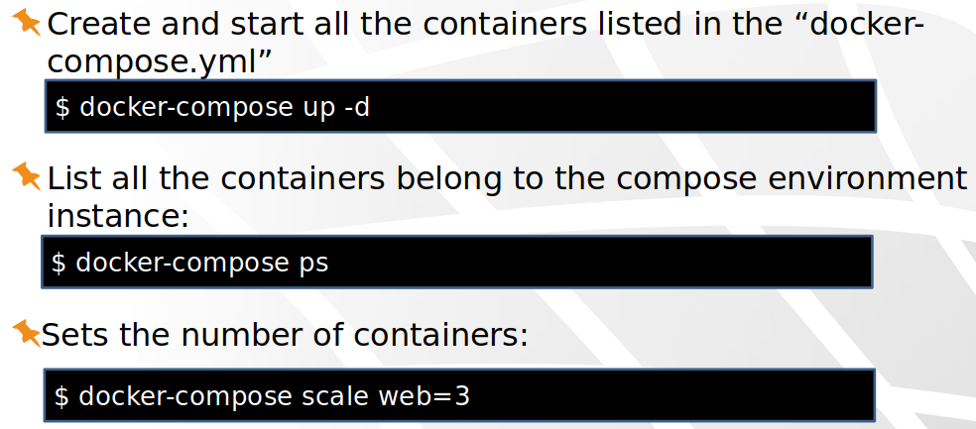
Basic Commands

Slide 6
Hands-on: Assignment 2 – Spring boot
Run the spring boot app without docker
Dockerize the spring boot app
Build docker image
Run the app with docker
Push the image to Docker Hub (Public docker registry)
Verify in another machine

Slide 7
Resources
Instructions and source code for the hands-on is available at this location:
https://github.com/mbzama/docker-training

Slide 8
Thank You

